Slide 1
Digital Portfolio
STUDENT NAME : A. JAYASANKARI
REGISTER NO AND NMID : 20624U18041 and
8DBA2CE2268AEA88E0A4DEC33701B7BF DEPARTMENT : BSC.COMPUTER SCIENCE
COLLEGE : KAMBAN COLLEGE OF ARTS AND
SCIENCE FOR WOMEN /
THIRUVALLUVAR UNIVERSITY

Slide 2

PROJECT TITLE
INTERACTIVE Digital portfolio USING FRENT END
DEVELOPMENT

Slide 3


AGENDA
Problem Statement
Project Overview
End Users
Tools and Technologies
Portfolio design and Layout
Features and Functionality
Results and Screenshots
Conclusion
Github Link
3/21/2024 Annual Review

Slide 4
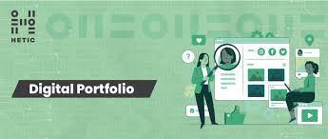
Digital Portfolio
A digital portfolio is an online collection of a person’s work, skills, achievements, and projects.
It serves as a dynamic resume that allows students, job seekers, and professionals to showcase their talents interactively through websites, images, documents, videos, and links.

Slide 5

PROBLEM STATEMENT
Traditional resumes are static and cannot fully showcase skills or projects.
Students and professionals need a digital portfolio to present their work in a dynamic, interactive, and accessible way for employers and recruiters.

Slide 6

PROJECT OVERVIEW
This project is a digital portfolio website built using HTML, CSS, and JavaScript.
It includes sections like Home, About, Projects, and Contact, allowing users to easily explore skills, achievements, and project work.

Slide 7


WHO ARE THE END USERS?
Students – to showcase academic and project work
Job Seekers – to highlight skills for recruiters
Employers/Recruiters – to evaluate candidates easily
Freelancers – to present their work to clients

Slide 8

TOOLS AND TECHNIQUES
Languages: HTML, CSS, JavaScript
Editor: VS Code / CodePen
Version Control: Git & GitHub
Design Concepts: Responsive Design, Flexbox, Grid Layout

Slide 9
POTFOLIO DESIGN AND LAYOUT
About Section – Profile photo, bio, and career goals
Projects Section – Cards or gallery with project details, live demo, and GitHub links
Contact Section – Simple contact form with validation, plus social links
Footer – Copyright and credits
Layout Style – Clean, modern UI with responsive design (works on mobile, tablet, and desktop)
Header / Home Section – Attractive title, tagline, and sticky navigation bar
Color Theme – Blue gradient with professional fonts for readability

Slide 10

FEATURES AND FUNCTIONALITY
Sticky navigation bar for easy browsing
Responsive design (mobile, tablet, desktop)
Interactive About section with profile info
Projects showcase with Demo & GitHub links
Contact form with validation
Footer with copyright details

Slide 11

Objectives of the Project
Showcase academic and personal projects
Improve visibility for job opportunities
Build confidence in front-end development
Create a professional and interactive online portfolio

Slide 12

Career Impact
Increases chances of getting internships and jobs
Acts as a living resume
Helps in freelancing and client projects
Builds a professional digital identity

Slide 13

Development Methodology
Designing – Create UI/UX structure
Coding – Develop using HTML, CSS, JavaScript
Planning – Decide sections and layout
Testing – Check responsiveness and features
Deployment – Publish on CodePen / GitHub Pages

Slide 14

Scope of the Project
In Scope: Website design, responsiveness, project showcase, contact form
Out of Scope: Backend integration, advanced database storage

Slide 15
Innovative Features
Interactive contact form
Responsive layout for all devices
Project cards with live demo & GitHub links
Sticky navigation bar for smooth browsing

Slide 16

Software Architecture
Frontend-based portfolio hosted on CodePen/GitHub Pages.
Interactive UI with JavaScript funct

Slide 17
Future Enhancements
AI-powered resume and project recommendations
Dark mode and customizable themes for better user experience
Adding blogging or article-writing feature inside the portfolio
Support for multimedia elements (videos, animations, 3D models
Integration of backend for storing user data and portfolio analytics

Slide 18
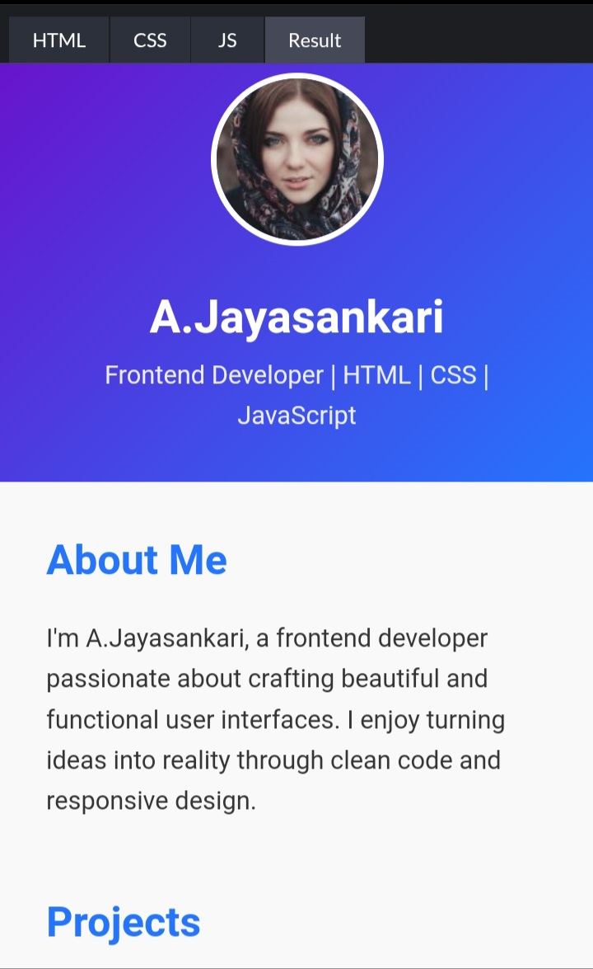
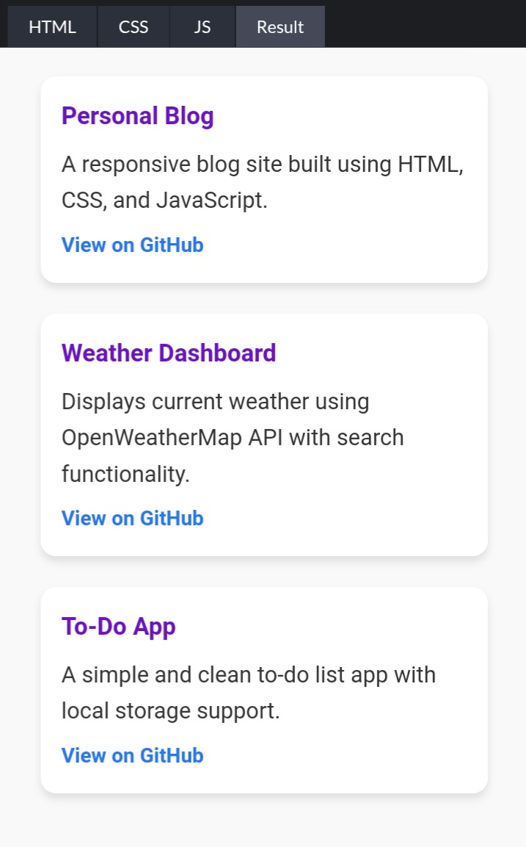
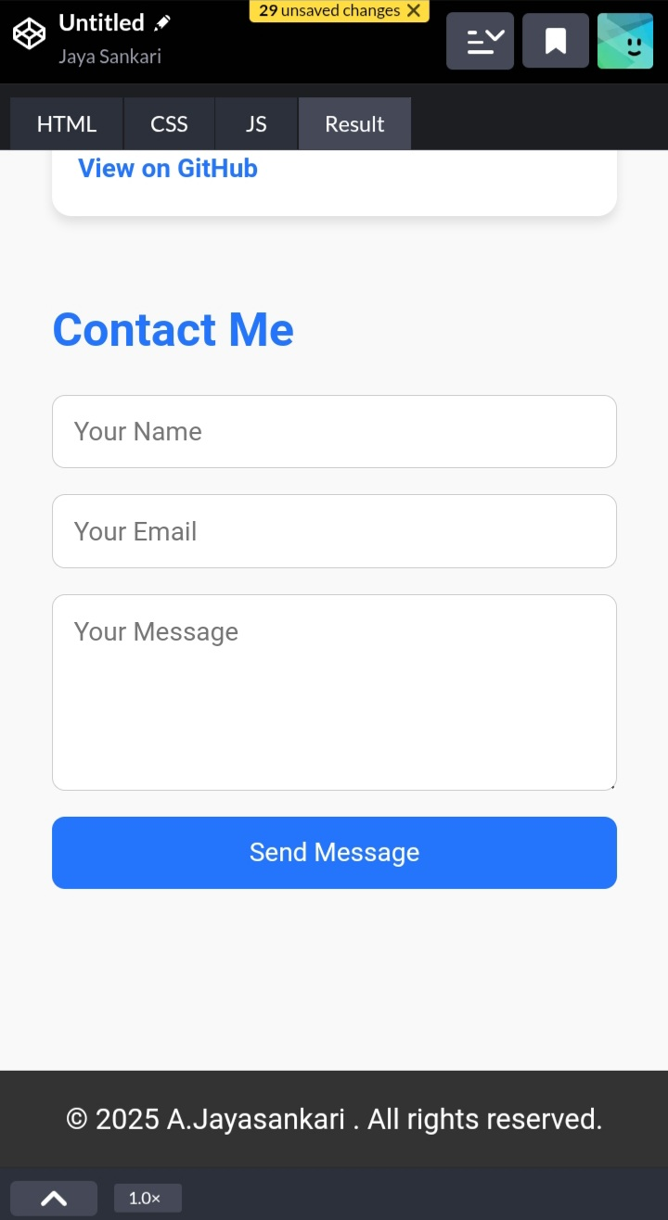

RESULTS AND SCREENSHOTS
✅ Portfolio website successfully developed and deployed ✅ Showcases Home, About, Projects, and Contact sections ✅ Fully responsive design (works on mobile, tablet, desktop) ✅ Enhances professional visibility for job and internship opportunities
3/21/2024 Annual Review

Slide 19
CONCLUSION
This digital portfolio provides a modern and interactive platform to showcase skills, projects, and achievements.
It demonstrates practical knowledge of HTML, CSS, and JavaScript, along with responsive web design.
The portfolio improves professional visibility by acting as a living resume, accessible anytime and anywhere.

Slide 20
THANK YOU

